Slide 1


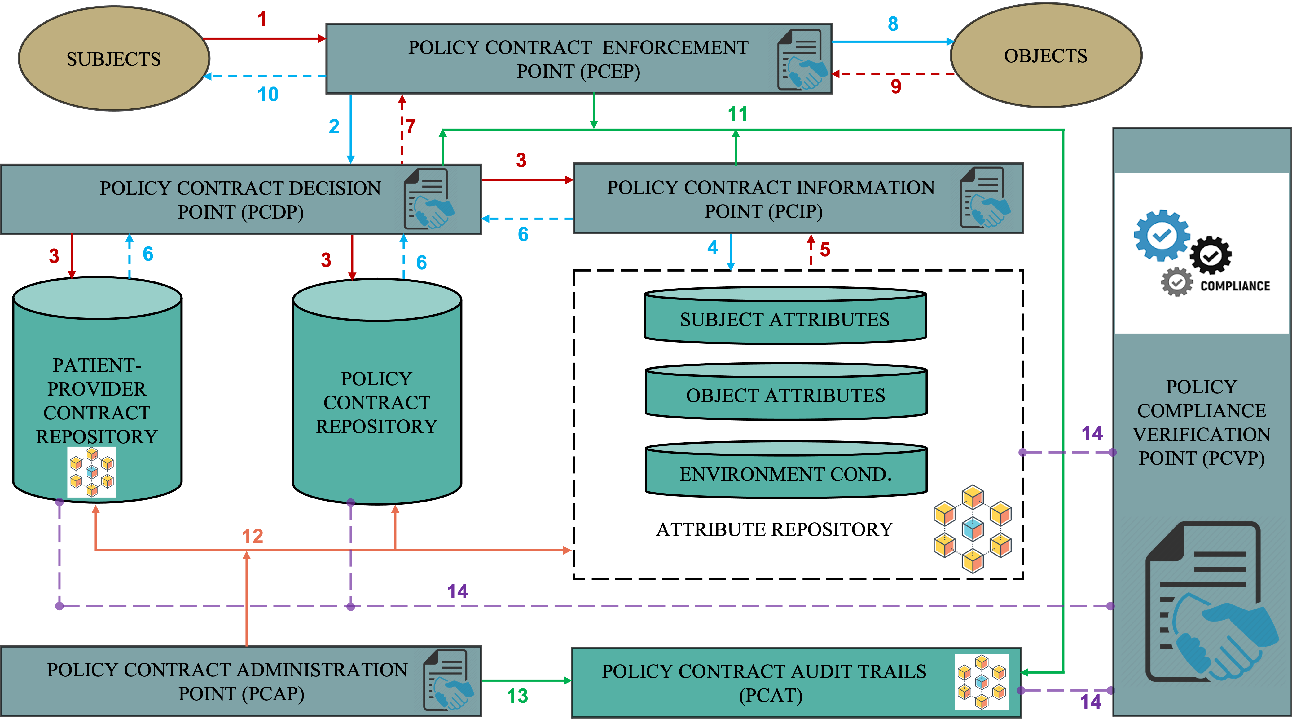
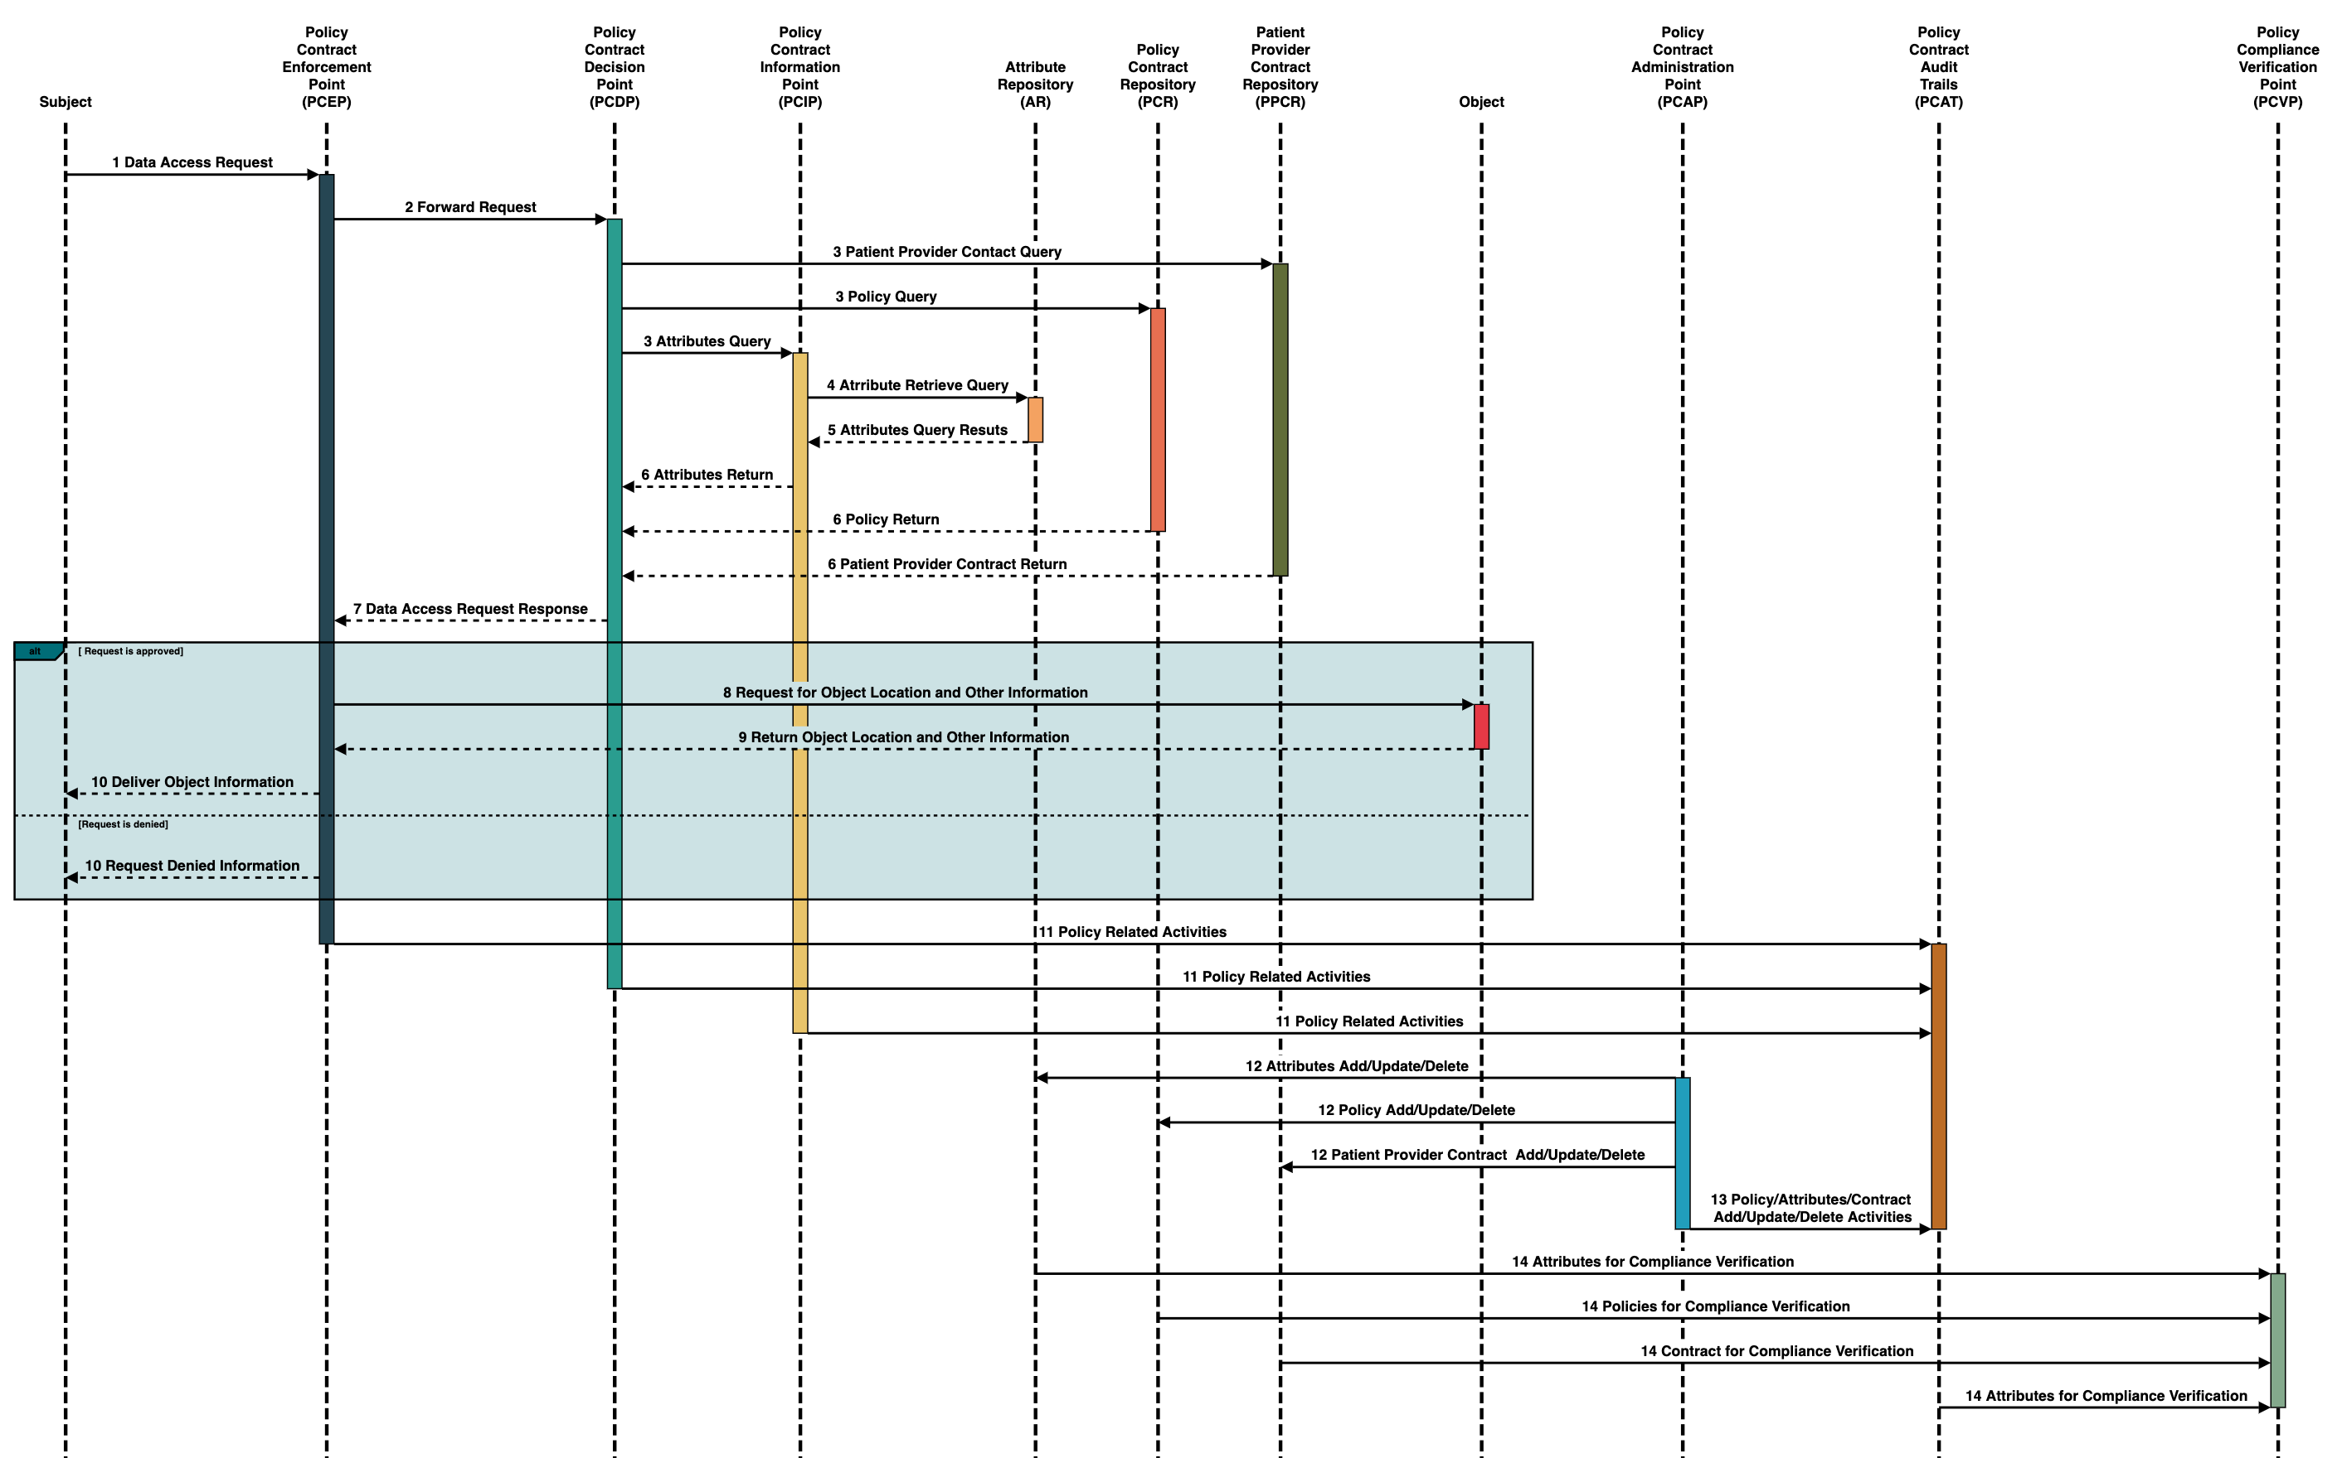
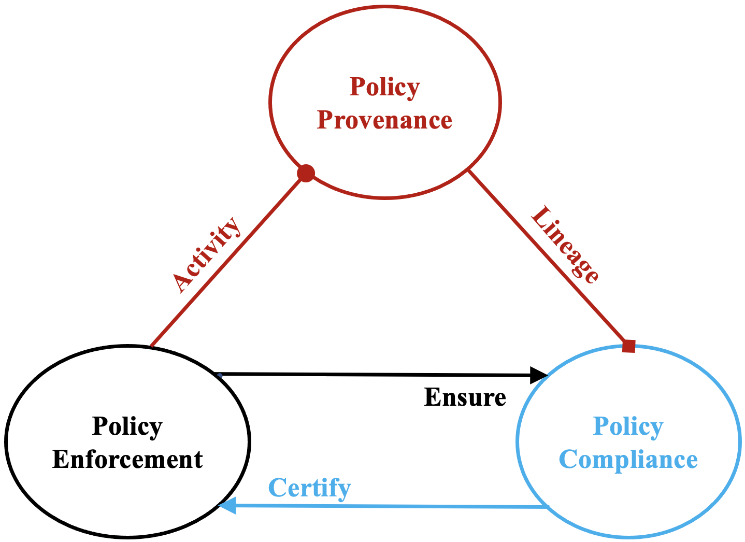
Blockchain Smart Contracts for Policy Compliance :
A Healthcare Perspective
Hemanth Chowdary, Md Al Amin, Seshamalini Mohan, and Indrajit Ray
Computer Science Department, Colorado State University, Fort Collins, CO, USA
Problem Statement
Contract Based Policy Enforcement
Provenance via Blockchain
For stronger security guarantees, demonstrating / proving policy compliance is must
Policy compliance is challenging since policies can range from national level policies to state-level, city-level, organization-level policies, and also individual user level
Problems in policy specification and implementation remain unidentified until a breach
Organizational subcultures often lead to policy violations
Blockchain
Smart Contract
Attribute Integrity
Access Control Integrity
Storage
Policy, Audit Trails
Blockchain
Component
Service
Policy Integrity
Hash (Policy, Attributes, Access Control, Health Records, Audit Trails)
Proposed Approach
A blockchain’s decentralized consensus mechanism and immutable, integrity verified storage helps provenance by maintaining better audit trail
Implementing policies as smart contracts ensures compliance via auto triggering and consensus mechanism doubles as strong reference monitor
Proof of Compliance (PoC) blockchain consensus mechanism to verify compliance and non-compliance actions
Healthcare Policy Compliance
Policy Compliance Sequence Diagram
Future Directions
Implementing prototype of the proposed model
Providing verification process of deployed policies and attributes
Integrating blockchain API with access control model to interact with blockchain network
Developing mechanism for audit trails verification for a certain user to confirm policy compliance
Building query API for performing different queries regarding policy compliance for a user/policy/an object
References
[1] Y. Piao, K. Ye, and X. Cui, “A Data Sharing Scheme for GDPR-Compliance Based on Consortium Blockchain,” Future Internet, vol. 13, no. 8, Art. no. 8, Aug. 2021, doi: 10.3390/fi13080217.
[2] Al Amin, M.; Altarawneh, A. and Ray, I. (2023). Informed Consent as Patient Driven Policy for Clinical Diagnosis and Treatment: A Smart Contract Based Approach. In Proceedings of the 20th International Conference on Security and Cryptography - SECRYPT; ISBN 978-989-758-666-8; ISSN 2184-7711, SciTePress, pages 159-170.
[3] Al Amin, M.; Altarawneh, A. ; Sarkar, S. and Ray, I. 2023, August. Blockchain Smart Contracts for Policy Compliance: A Healthcare Perspective. In 3rd International Conference on Emerging Trends in Networks and Computer Communications (ETNCC 2023) IEEE.
[4] W. Charles, N. Marler, L. Long, and S. Manion, “Blockchain compliance by design: Regulatory considerations for blockchain in clinical research,” Front. Blockchain, p. 18, 2019.
[5] M. Shuaib, S. Alam, M. Shabbir Alam, and M. Shahnawaz Nasir, “Compliance with HIPAA and GDPR in blockchain-based electronic health record,” Mater. Today Proc., Mar. 2021, doi: 10.1016/j.matpr.2021.03.059.
[6] A. Hasselgren, P. K. Wan, M. Horn, K. Kralevska, D. Gligoroski, and A. Faxvaag, “GDPR Compliance for Blockchain Applications in Healthcare,” ArXiv Prepr. ArXiv200912913, 2020.

